Slide 1
Celebrity.AI
Fetch.AI Hackathon 2025 Dubai

Slide 2

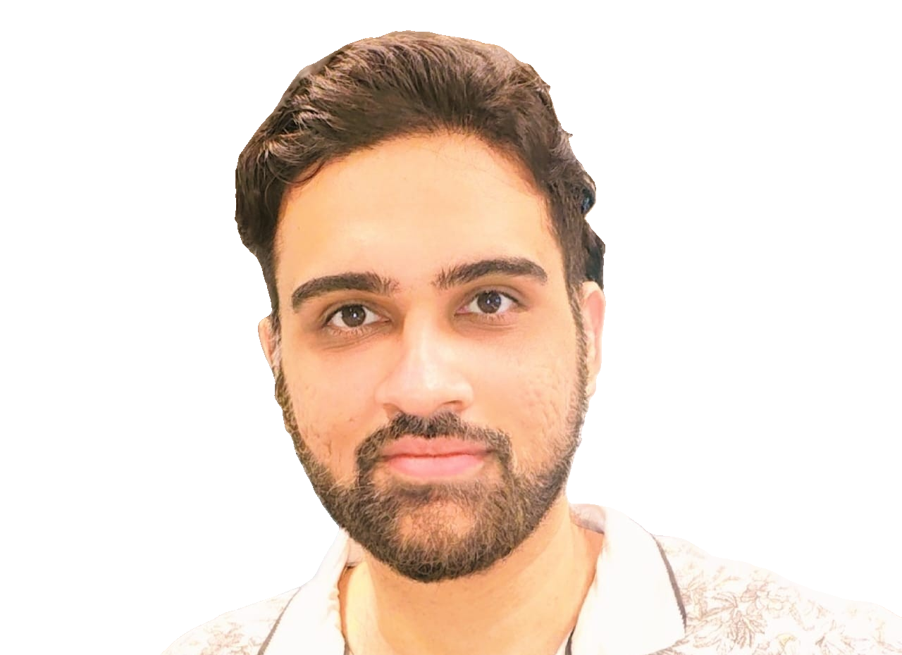
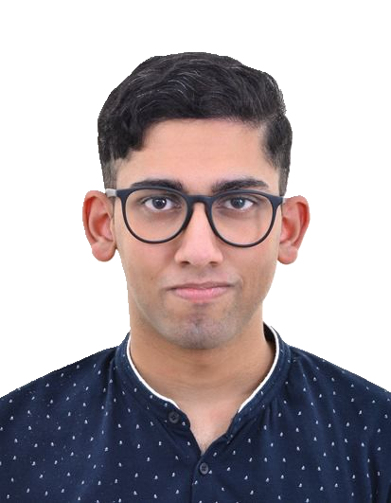
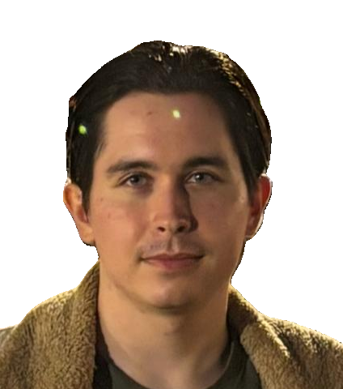

The TEAM
Raj Rangwani
Joe perinchery
Timur mazitov
Software Developer
Software Developer
Software Developer​
n1yah
Special Celebrity Guest
Music Artist

Slide 3
Who Wants to Live Forever
“
”
film Highlander

Slide 4
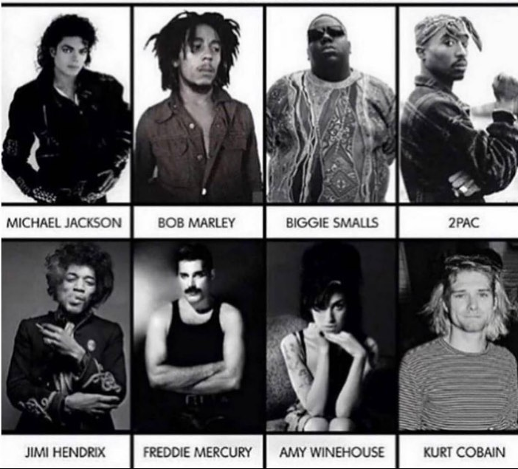
Who Do YOU Want to be "Live" Forever?

Slide 5
What we are building
Digital Replica of Musical Artists
Voice Clone and TTS
24 hours access forever

Slide 6
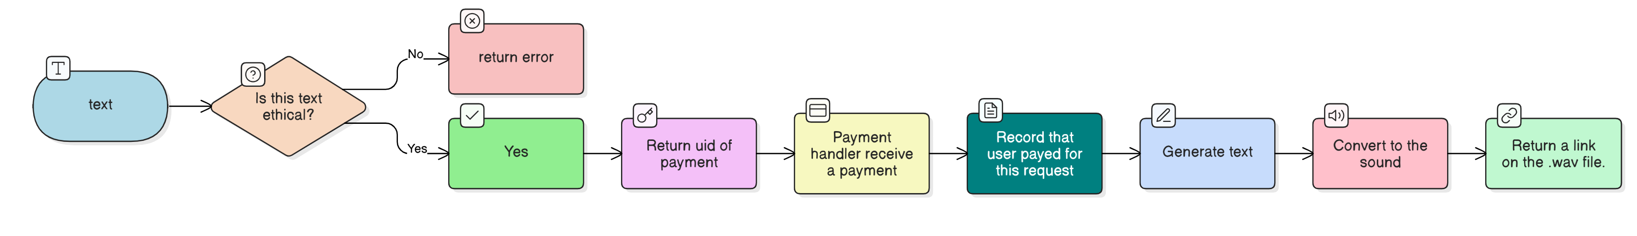
Process

Slide 7
future plans
From Speech to Music Gen
3d Modeling Combo
Train Models to Mimic Artist Music and Singing Style
Users Can Co-Create Using Artist Style
Royalties Shared, Smart Contracts, NFTS
3D Scan Person
AI-Gen 3D Digital Replica
Digital Clone

Slide 8
Thank You
Raj Rangwani,
Joe Perinchery,
Timur Mazitov,
..and N1yah

